Slide 1


Constraining production uncertainties of heavy mesons via measurement of the prompt atmospheric component using IceCube - F3 - Ludwig Neste, Mirco Hünnefeld and Pascal Gutjahr
SFB1491 General Assembly, Dortmund 2023
Source: NASA

Slide 2
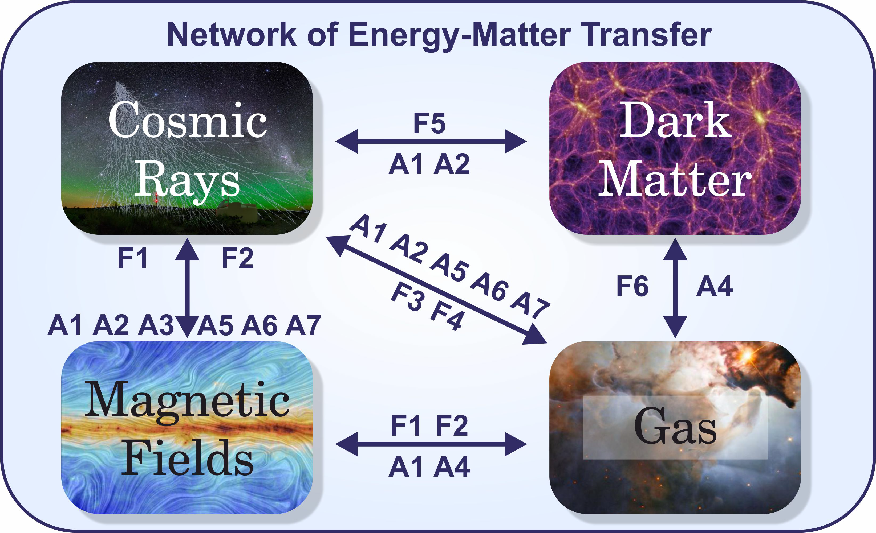

Slide 3
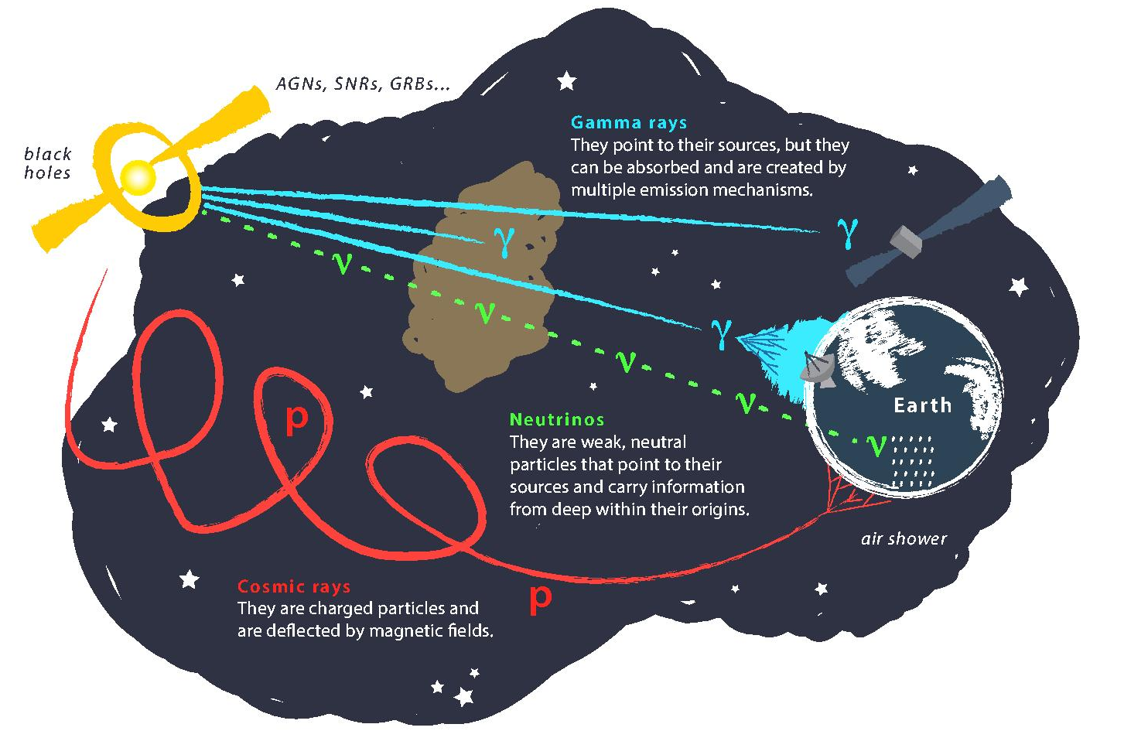
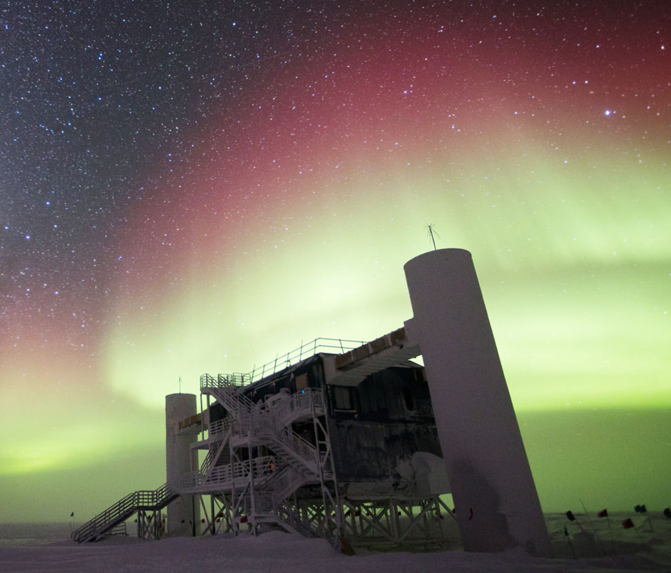
Astroparticle physics
gallery.icecube.wisc.edu
Credit: IceCube / NSF

Slide 4
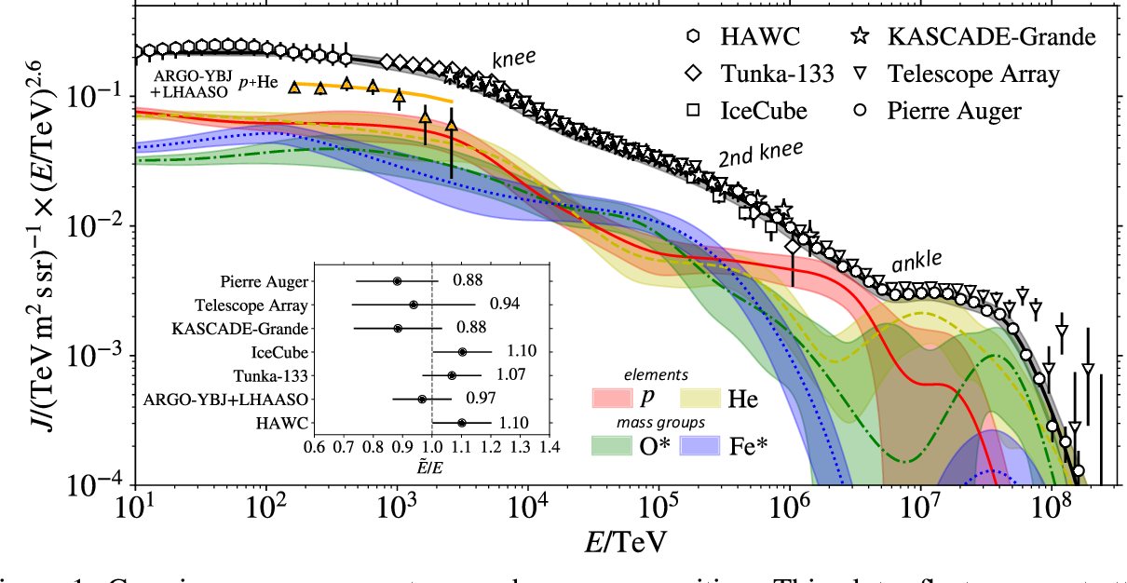
Cosmic ray flux
1903.07713

Slide 5
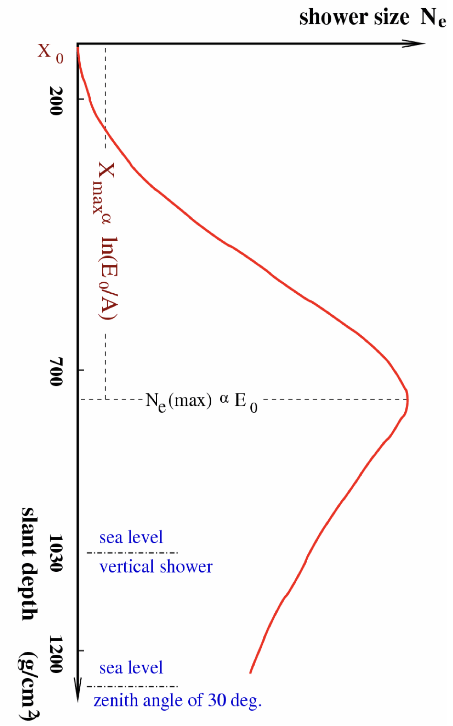
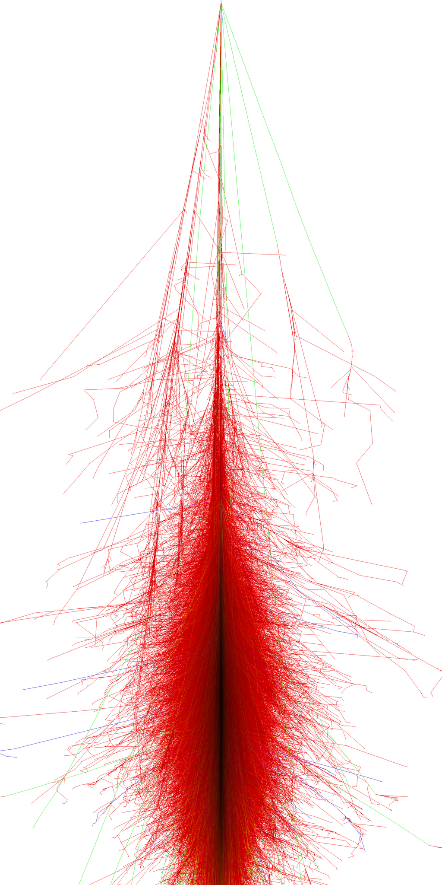
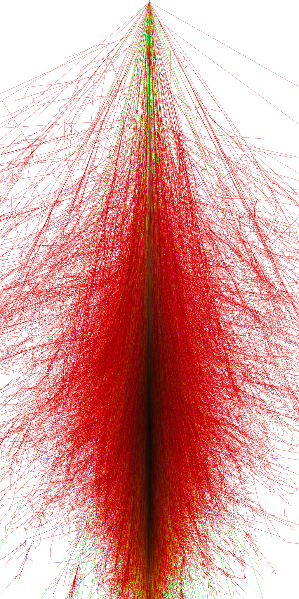
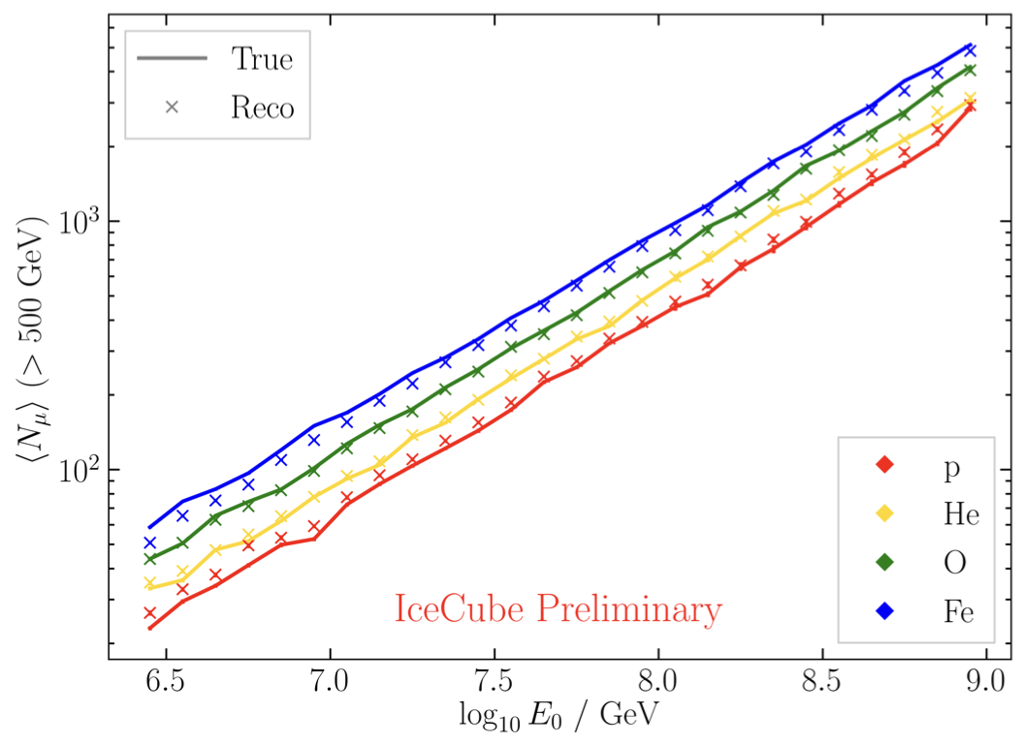
Air shower – 10 TeV
“muon bundles”
zeuthen.desy.de
Ralph Engel 2005
2211.16970v2
Proton
Iron

Slide 6
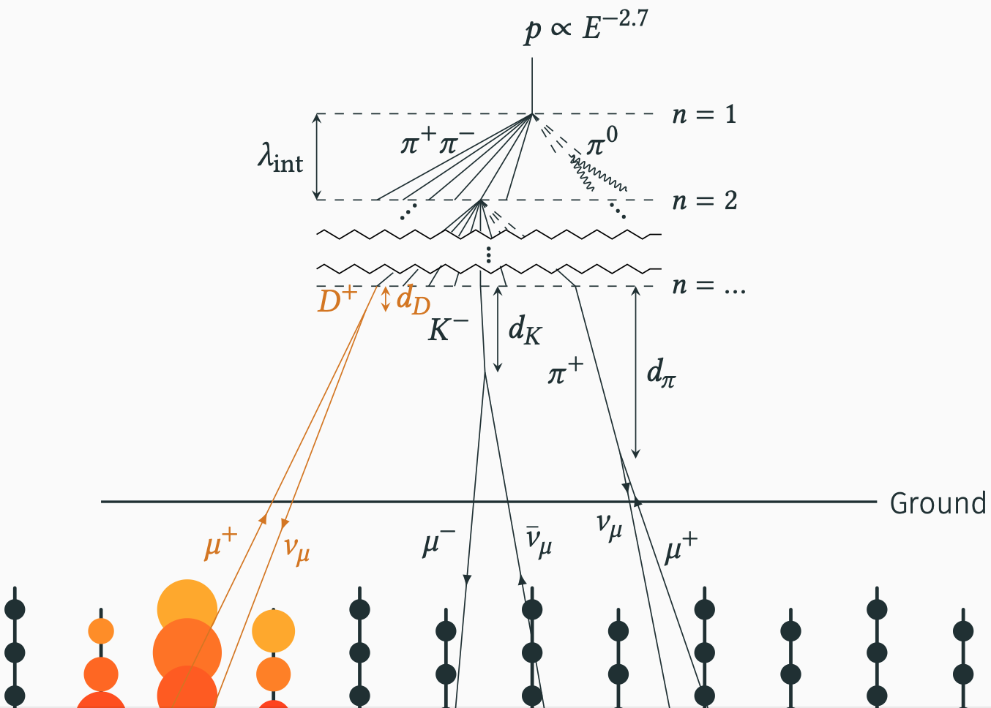
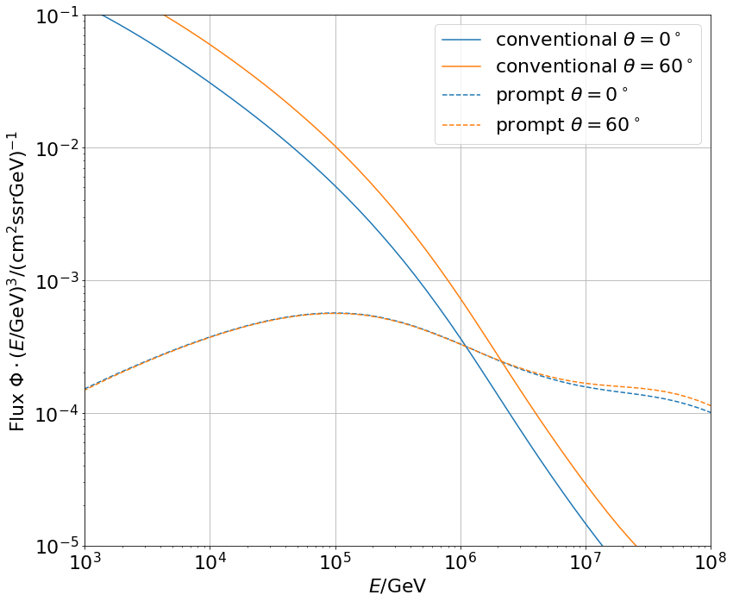

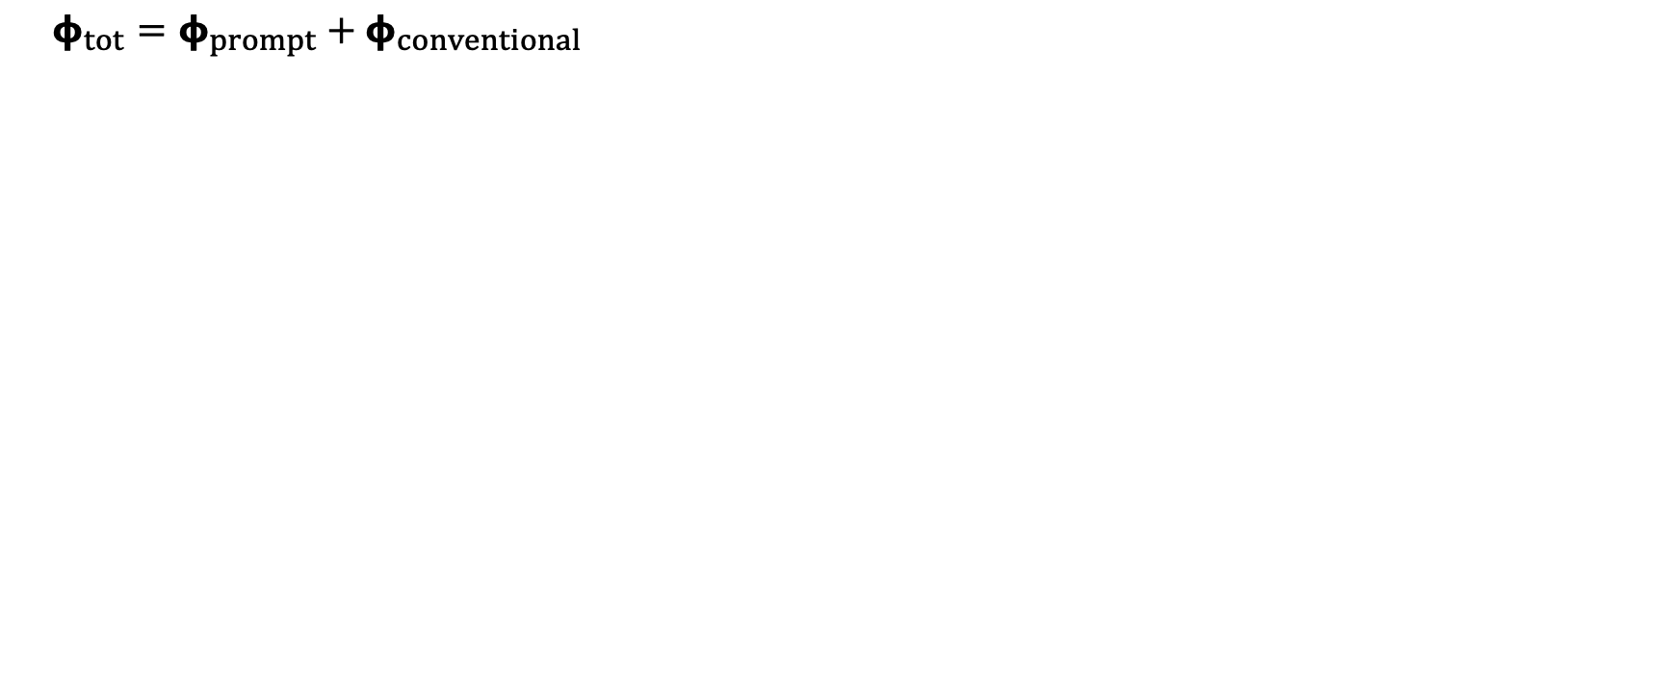
Muon flux: Definition of prompt
Most energetic muon in bundle
Muon parent:
pion or kaon
$φ_{tot}=φ_{prompt}+$ $φ_{conventional}$
yes
no
conventional
prompt
0°: perpendicular to Earth’s surface
conventional
prompt

Slide 7
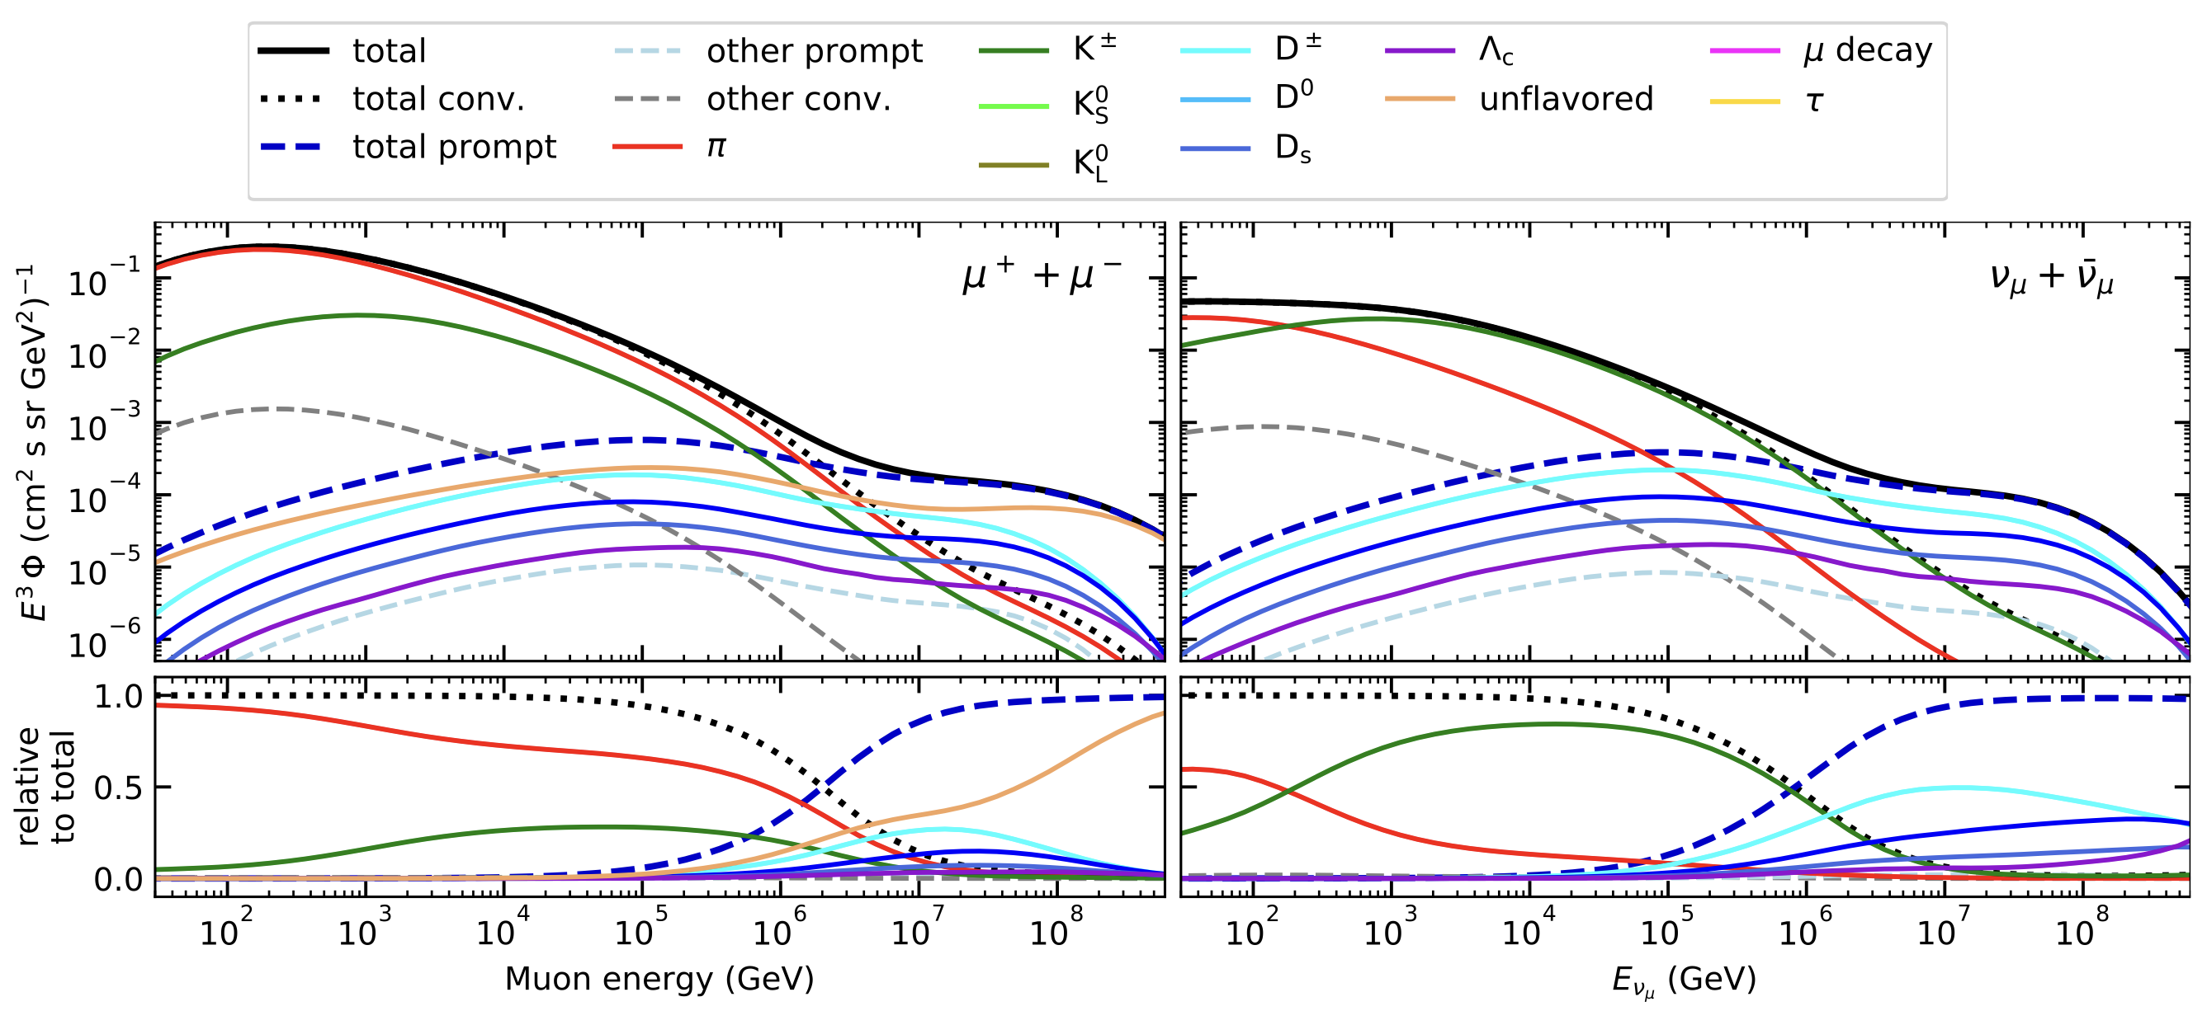
Prompt atmospheric muons and neutrinos
10.1103/PhysRevD.100.103018
no unflavored
dominated by pions
dominated by kaons
Combined fit:
handle on pion/kaon ratio
handle on charmed mesons

Slide 8
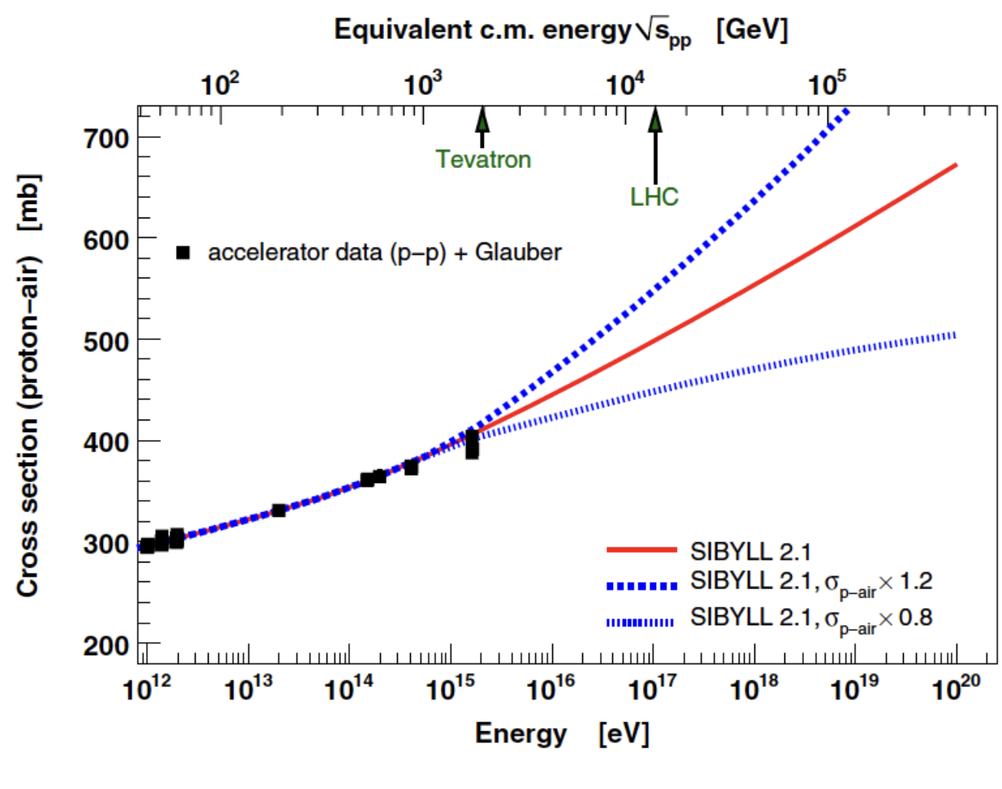
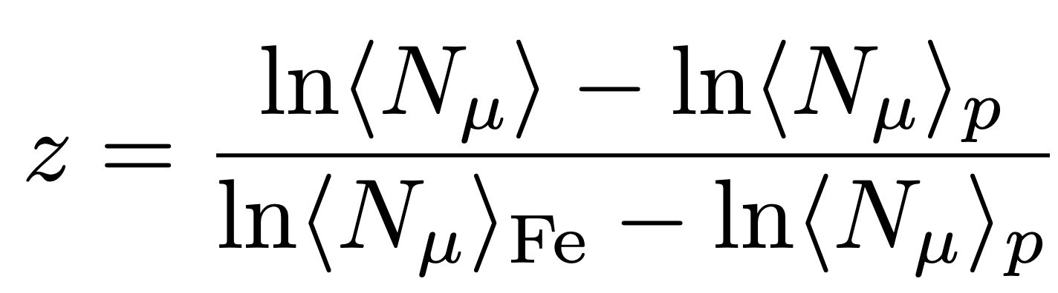
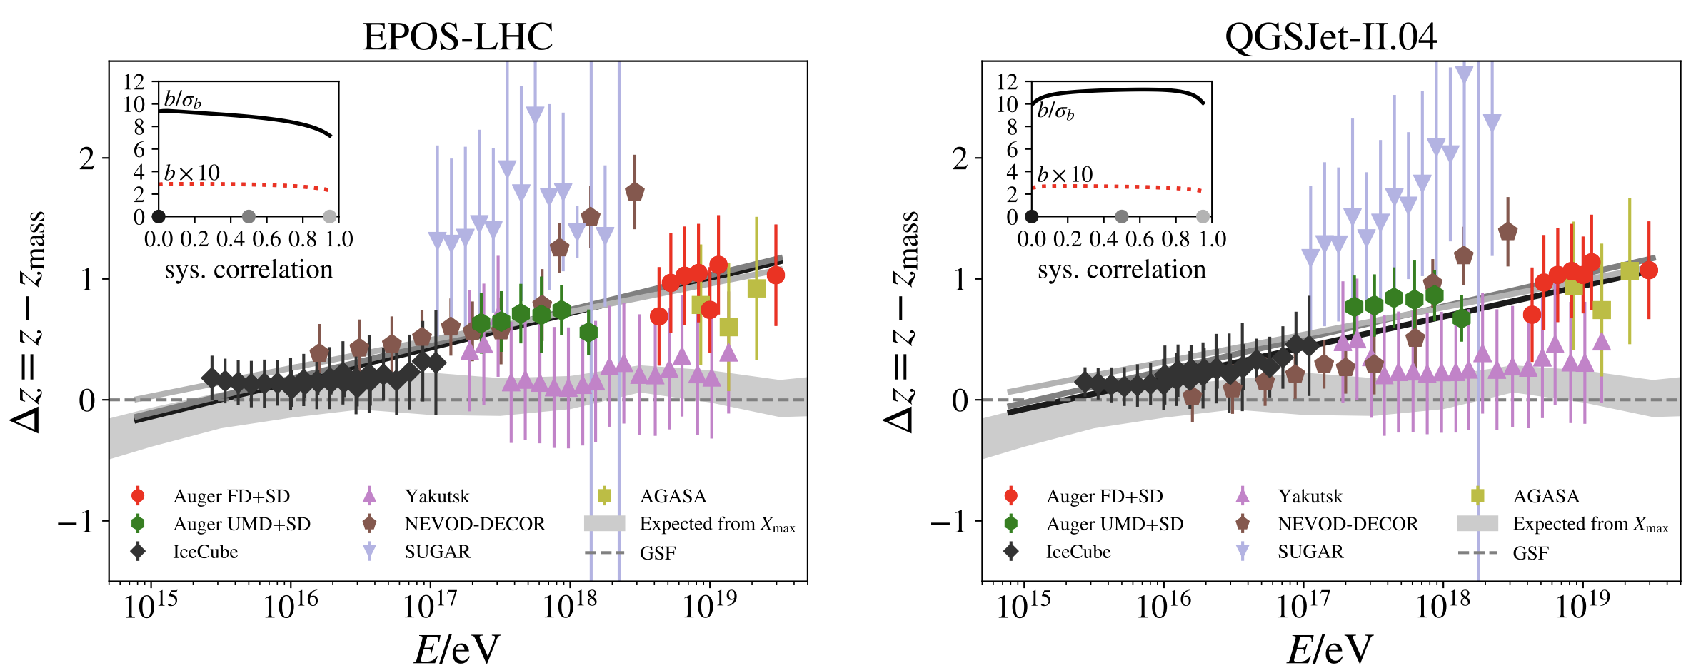
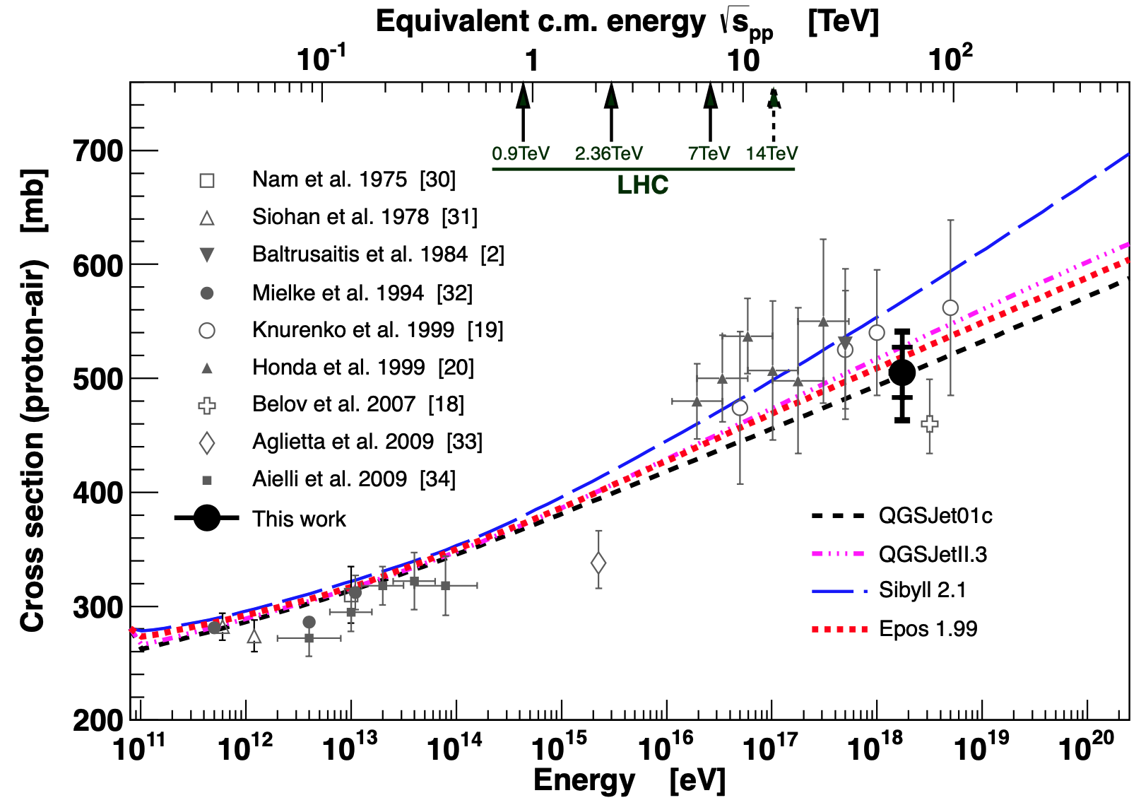
Muon Puzzle and model uncertainties
”muon number”
Expected z
(“muon number)
2108.08341
10.1103/PhysRevD.83.054026
More muons measured than simulated for E > 40 PeV ~ cms 8 TeV
1208.1520
Large uncertainties at E > 10 PeV

Slide 9
F3/F4 Overview
F3 (“Prompt lepton production in hadronic interactions”)
F4 (“Cross sections and hadronic interactions in particle- and astroparticle physics”)
F3.1 (W. Rhode, IceCube)
Deliverables:
Year 1/2:
Establish analysis framework for prompt muon measurement
First (preliminary) results will be produced
Upgrade MC generators for necessary comparisons and alignments to F3 and F4
Year 3/4:
Continue systematic studies for prompt muon measurement
Publication of prompt muon measurement
Further work on unifying F3/4 results for MC generators

Slide 10
First: Atmospheric prompt muons
Detect prompt component of the atmospheric muon flux
Measure the normalization
Get handle on hadronic interaction models
Unfold a muon energy spectrum
Idea:
New CORSIKA simulations with extended history
Tag muons by parent → prompt or conventional
Scale amount of prompt particles
Scaling saves time and resources instead of doing multiple simulations with different interaction models
Perform forward fit of the prompt normalization

Slide 11
CORSIKA 7 tagging and MCEq comparison
MCEq: tool to numerically solve the cascade equations that describes the evolution of particle densities as they propagate through a gaseous, dense medium
https://github.com/mceq-project/MCEq
GSF weighting
GSF weighting
Good agreement in total prompt and conv muon flux
D⁰ and D_{s} are swapped here but this is fixed in MCEq

Slide 12
Agreement for different primary models

Slide 13
Pseudo analysis

Slide 14
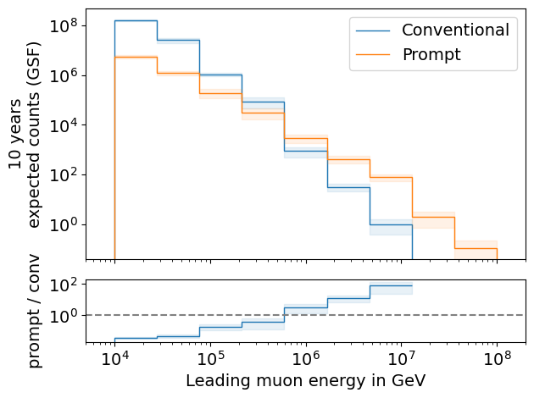
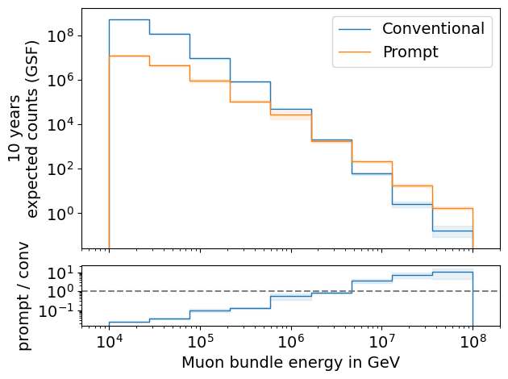
Expected muons for 10 years: leading vs. bundle energy (GSF)
leading: energy of most energetic muon in a muon bundle
bundle: sum of energies of all muons of the bundle
L2 MuonFilter
L2 MuonFilter
Both leading and bundle energy are sensitive to detect prompt
Leading muon energy is more sensitive

Slide 15
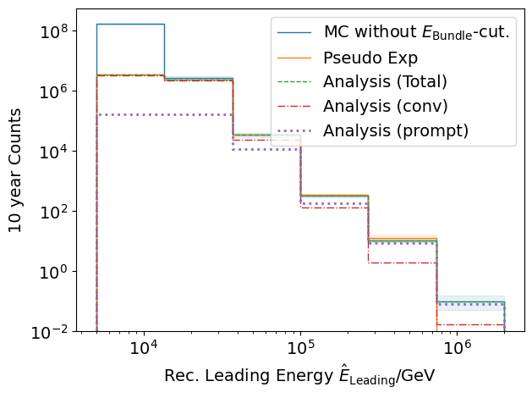
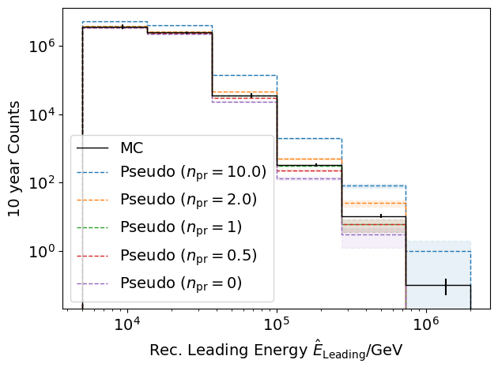
Pseudo data sampling
Cuts:
L2 MuonFilter
Bundle energy > 100 TeV
Tagging allows scaling of prompt by factor n_{pr}

Slide 16
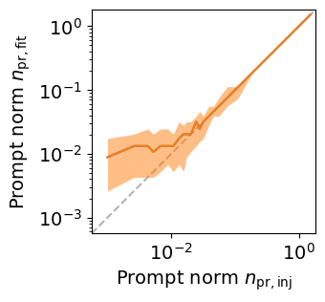
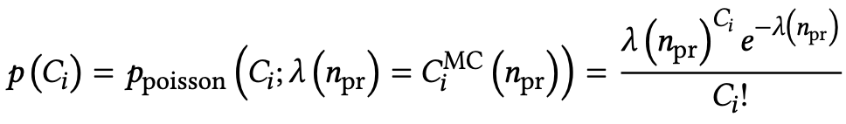
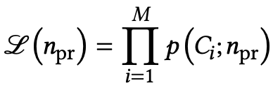
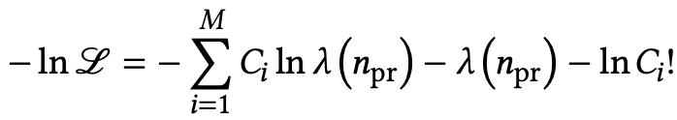
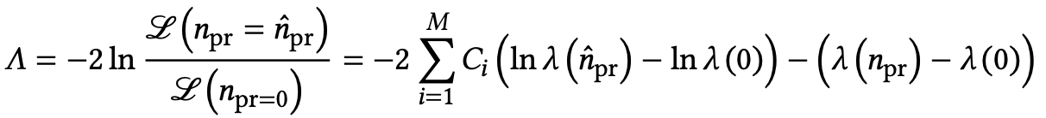
Poisson likelihood fit performed in leading muon energy
Cuts:
L2 MuonFilter
Bundle energy > 100 TeV
Test bias
Prompt scaling/normalization
MC counts per bin i
Conv norm = 1
Experimental counts
Maximize likelihood
With a constant conv norm:
bin counts depend only on prompt norm
= expectation value per bin
Easier:
minimize negative
log-likelihood
Test statistic for Wilks’ theorem
Bias starts at a prompt normalization of 0.1
Null hypothesis: no prompt

Slide 17
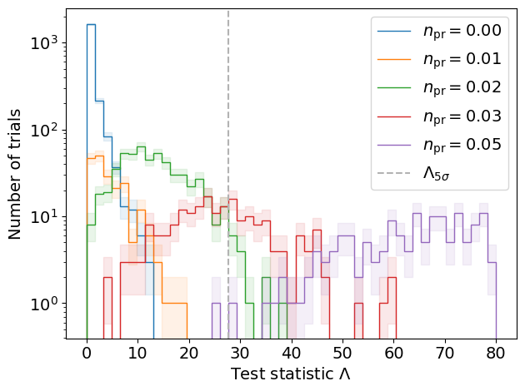
Discovery potential and sensitivity
Cuts:
L2 MuonFilter
Bundle energy > 100 TeV
Expectation for 1 year:
5 sigma discovery potential: 0.102 ± 0.005
Sensitivity: 0.024 ± 0.001
Expectation for 10 years:
5 sigma discovery potential: 0.032 ± 0.001
Sensitivity: 0.007 ± 0.000
Caution:
Limited MC statistics -> events are oversampled in pseudo dataset
No systematic uncertainties

Slide 18
Conclusion and outlook
✓
CORSIKA 7 test simulations
Prompt identification
MCEq comparison
Few-author paper in progress (publish early 2024)
First analysis chain for prompt muon normalization
Proceed analysis…(systematics etc.)
IceCube prompt muons paper (publish early 2025)
Prompt neutrino analysis
Tagging and MCEq comparison in progress (Lars Bollmann)
Combined fit (prompt muons + neutrinos)…future plan
F3/F4 Dortmund Meeting:
https://nextcloud.e5.physik.tu-dortmund.de/index.php/s/J5WGYQ6wBb9ndJM
✓
✓
★
✓
★
★
do we want to use this again?

Slide 19
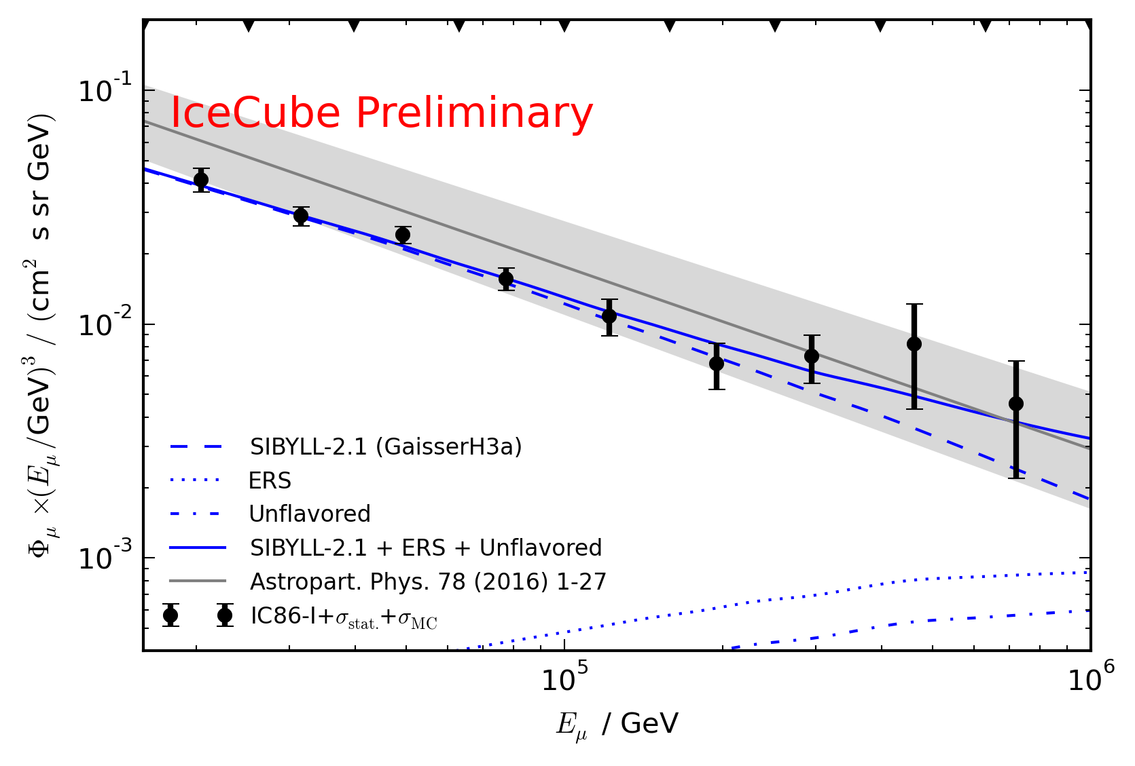
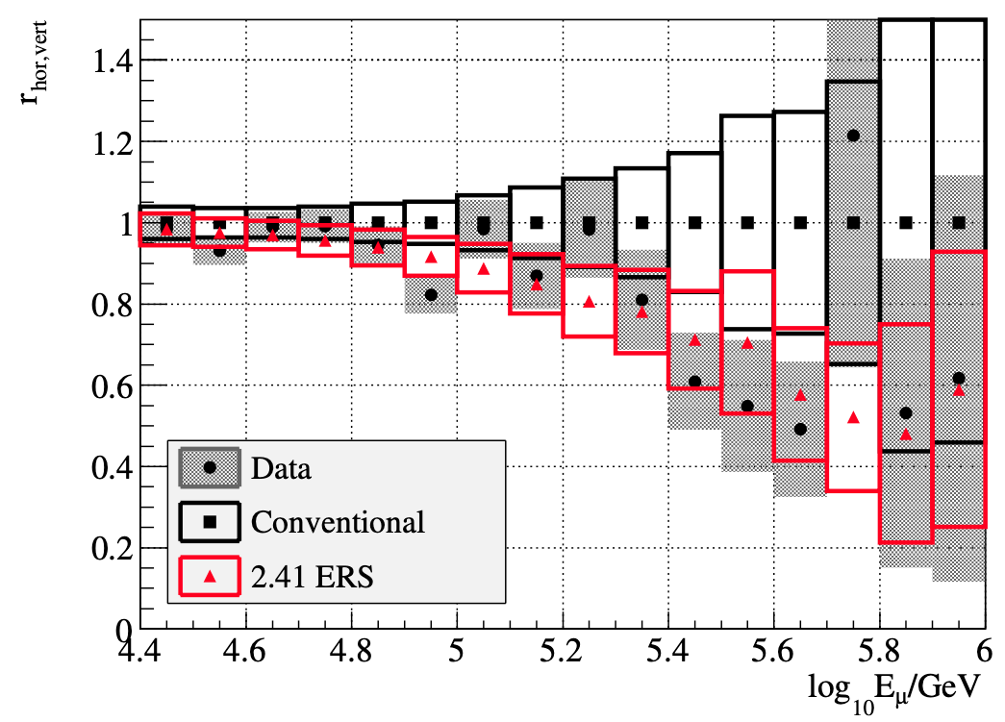
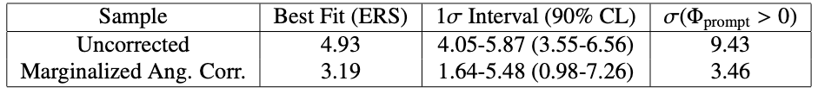
Motivation
Detect and measure normalization of prompt component of atmospheric muon flux
Constrain uncertainties on hadronic interaction models at very high energies
Old analyses:
Leading muon analysis: limited MC statistics (by Tomasz Fuchs, https://wiki.icecube.wisc.edu/index.php/Analysis_of_Leading_Muons)
Characterization of the muon flux: zenith problem (by Patrick Berghaus, https://arxiv.org/abs/1506.07981)
Good analyses with some challenges
Prompt MC truth not available -> new CORSIKA simulations

Slide 20
Motivation
where to move this slide?
muon puzzle
understand muon and neutrino flux at very high energies > PeV
collect data points to tune hadronic interaction models (high energies and high rapidity)
see talk by hans: there are already data points?! slide 16???
pin down background to measure astrophysical source at high energies
WHAT IS OUR MAIN MOTIVATION?! STUDY OBJECTS IN THE UNIVERSE AND FUNDAMENTAL PARTICLE PHYSICS? THEN MENTION THIS MOTIVATION AT THE BEGINNING

Slide 21
Overview
Most energetic muon inside
Muon parent:
pion or kaon
Final goals
Measure normalization of the atmospheric prompt muon flux
Unfold muon energy spectrum
Steps for normalization measurement
Verify CORSIKA extended history simulations
Tag prompt muons
Comparisons to MCEq
Set up preliminary analysis chain
Reconstruct muon energy and direction
Data/MC comparisons
Include systematics
Run full statistics simulation
Additional steps for unfolding
Effective area
yes
no
conventional
prompt
Terminology
Muon bundle: all muons in a bundle
Leading muon: most energetic muon in a muon bundle
Single muon: no single muons at high energies
Prompt muon: parent is pion or kaon
New (preliminary) CORSIKA Ehist simulation
CORSIKA 77420
SIBYLL 2.3d
600 GeV – 50 EeV
/data/sim/IceCube/2023/generated/CORSIKA_EHISTORY/

Slide 22
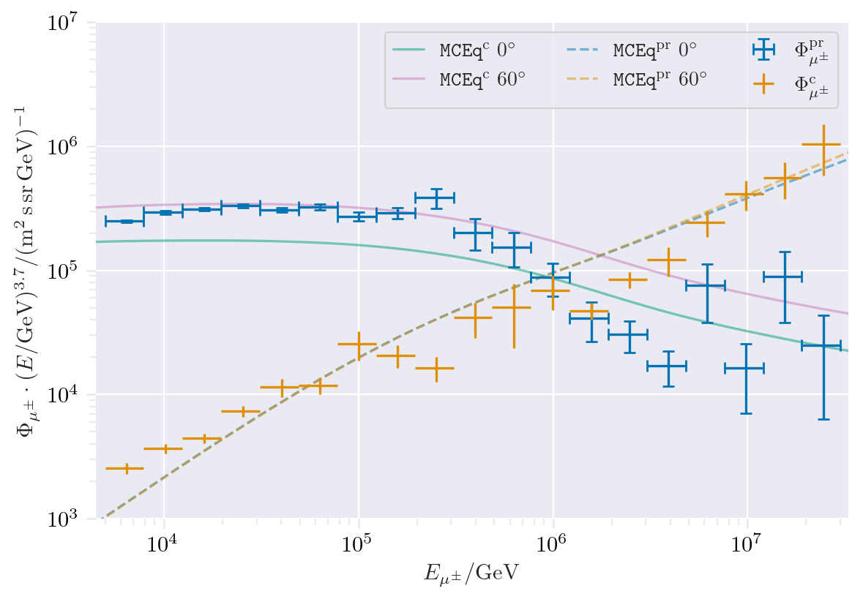
CORSIKA vs. MCEq
Most energetic muon inside
Muon parent:
pion or kaon
Presented by Ludwig Neste
yes
no
Good agreement
conventional
prompt
CORSIKA standalone
IceCube CORSIKA step 0

Slide 23
MC data exploration

Slide 24
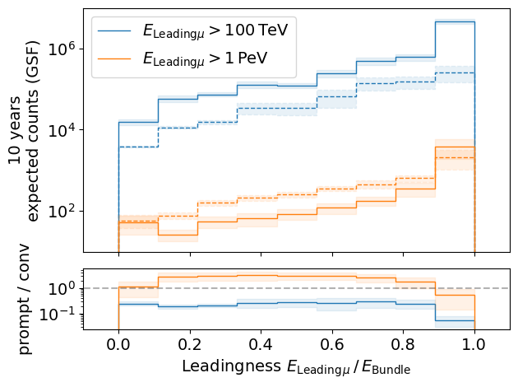
Leading muon energy fraction
Solid: conventional
Dashed: prompt
Prompt dominates for energies > 1 PeV
Leading energy sweet spot: 0.1 – 0.9

Slide 25
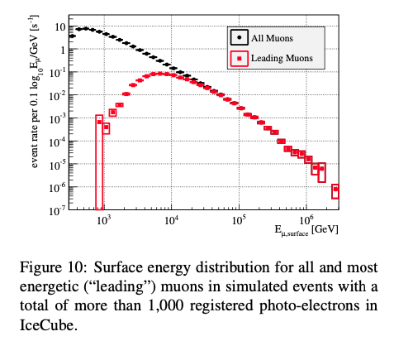
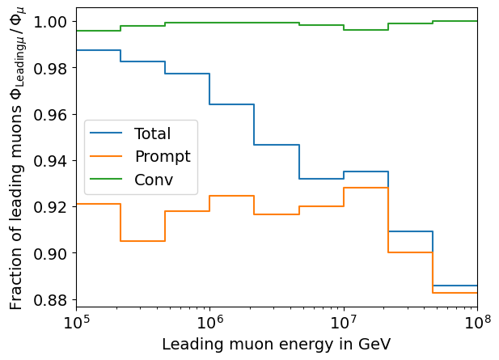
Leading muon contribution
Patrick Berghaus
Muons with energies between 100 TeV and 50 PeV dominate the bundle by more than 90%
In average conventional muons are more dominant than prompt
But: at high energies, there are more prompt than conventional events
High leading energy fraction does not lead to more sensitivity to detect prompt

Slide 26
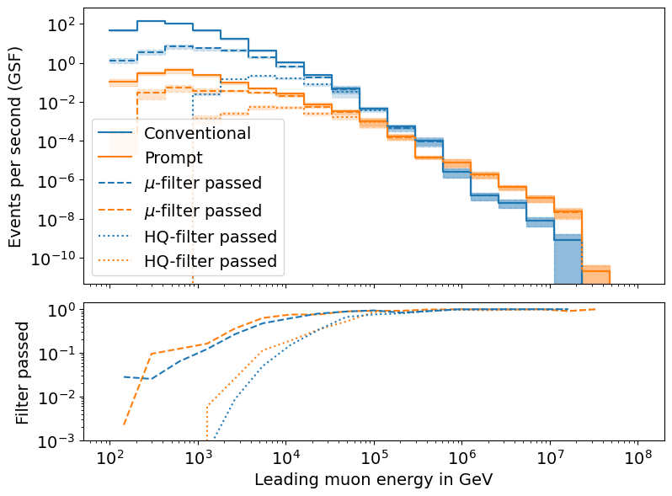
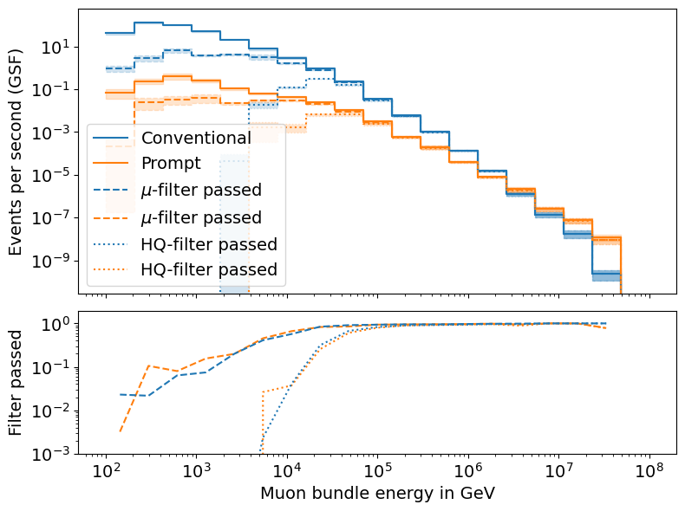
L2 Filters
Fraction events rejected | All energies | Leading energy > 10 TeV | Leading energy > 100 TeV
MuonFilter | 0.93 | 0.28 | 0.06
HQFilter | 0.99 | 0.74 | 0.18
Choose muon filter to remove large amount of statistics at low energies

Slide 27
DNN reconstructions

Slide 28
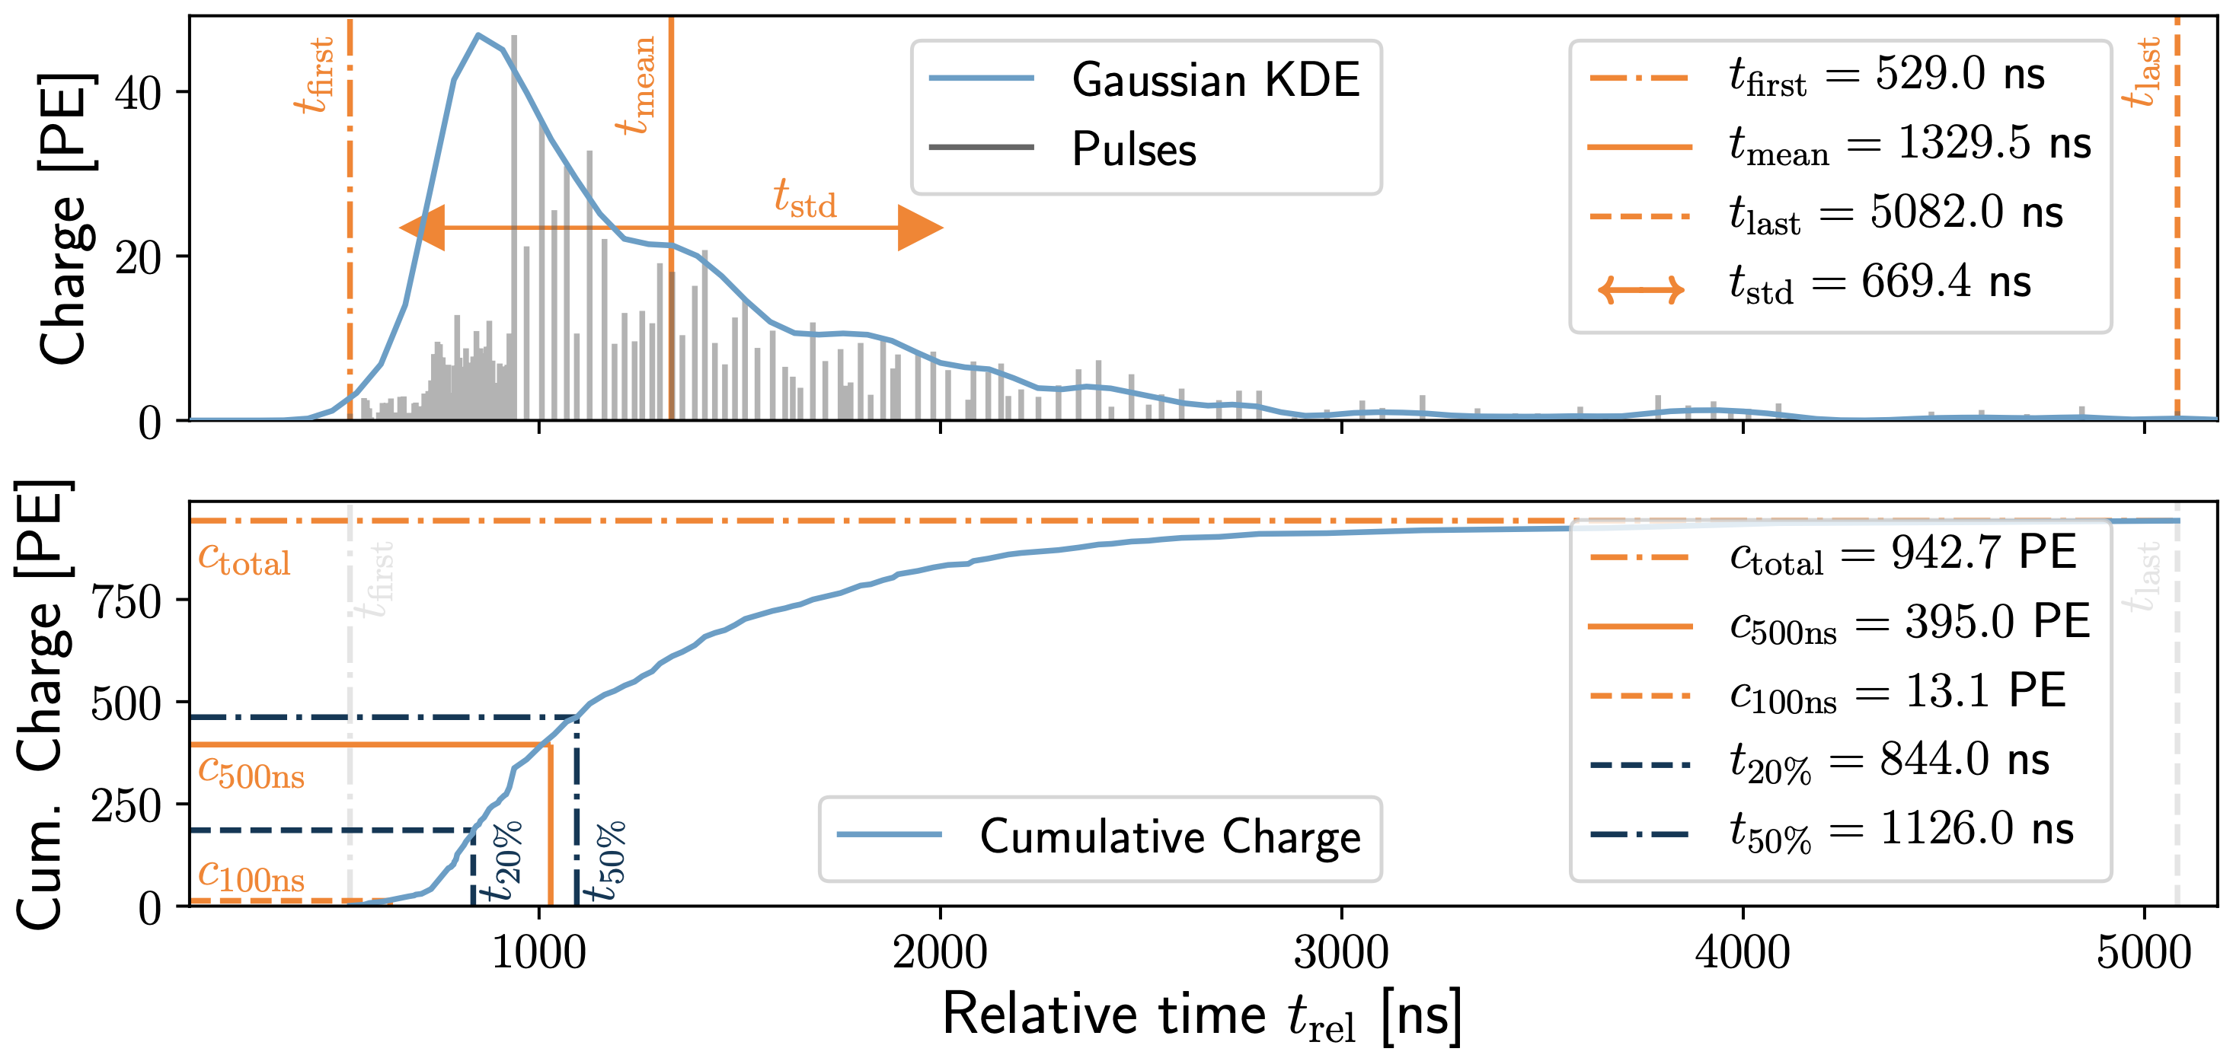
DNN Reconstructions
10.1088/1748-0221/16/07/P07041
Reconstruct
Muon bundle energy
Leading muon energy
Direction (zenith/azimuth)
Physics motivation
Muons lose energy stochastically
High leadingness: energy depositions are dominated by large stochastic losses
Low leadingness: stochastic losses sum up and appear continuously
High energies: forward production
High leadingness: small bundle radius
Low leadingness: larger bundle radius
Input data per DOM
Total charge
Sum of charge
Relative time of first pulse
Relative to total time offset, calculated as the charge weighted mean time of all pulses
Standard deviation of first pulse
Charge weighted standard deviation of pulse times relative to total time offset
SplitInIceDSTPulsesTWCleaning6000ns

Slide 29
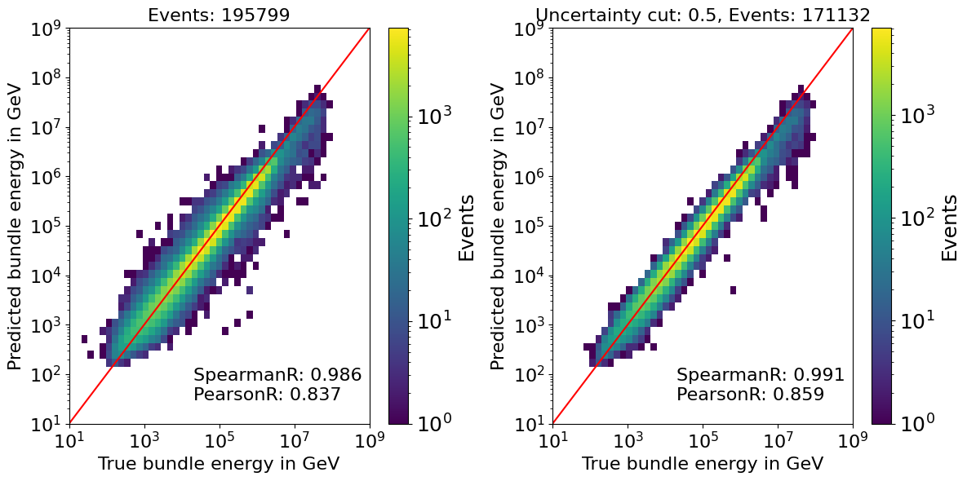
Bundle energy reconstruction

Slide 30
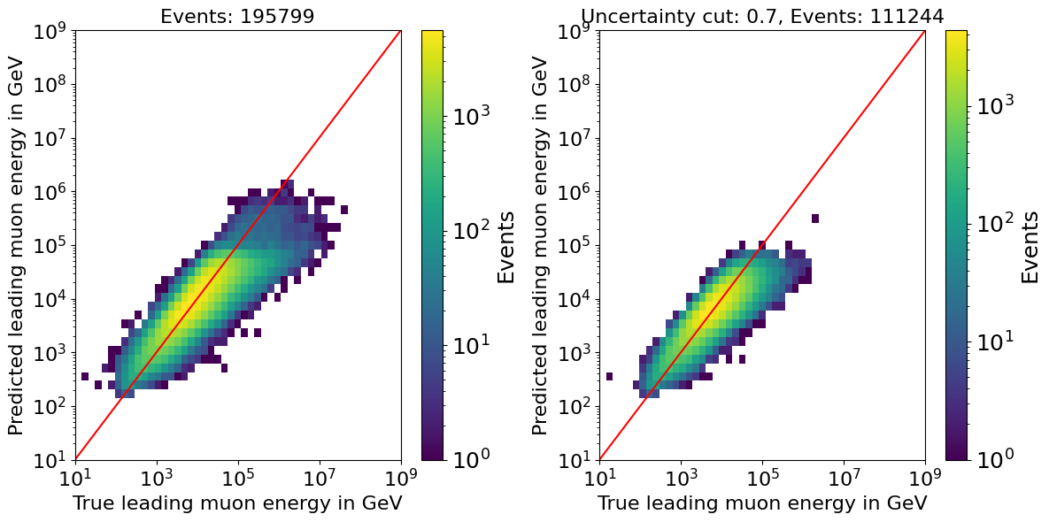
Leading energy reconstruction

Slide 31
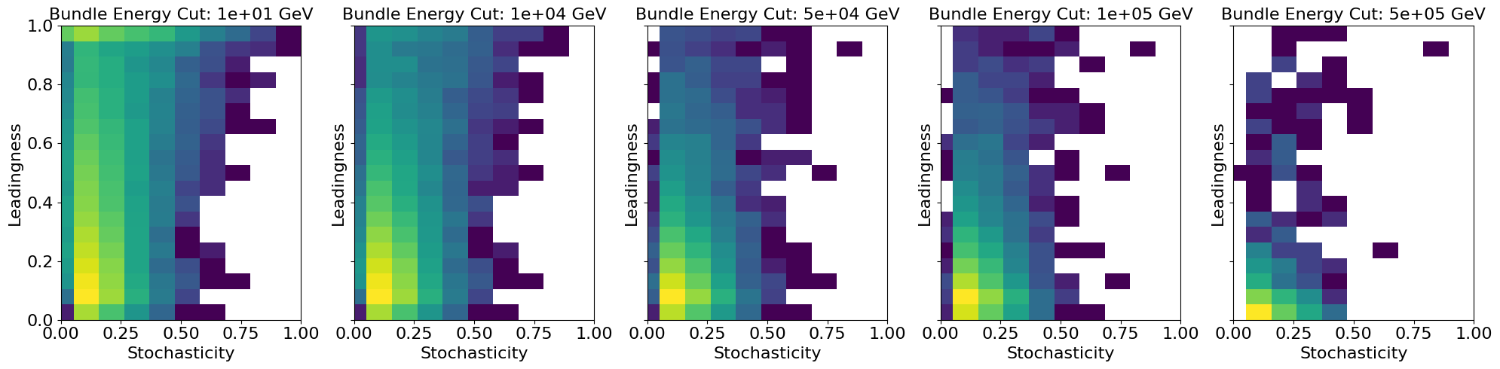
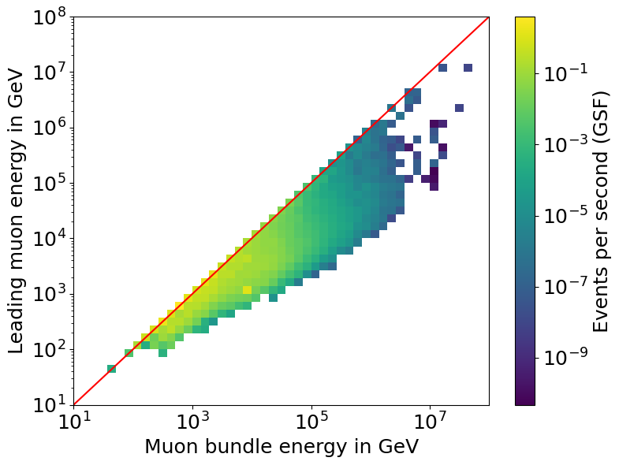
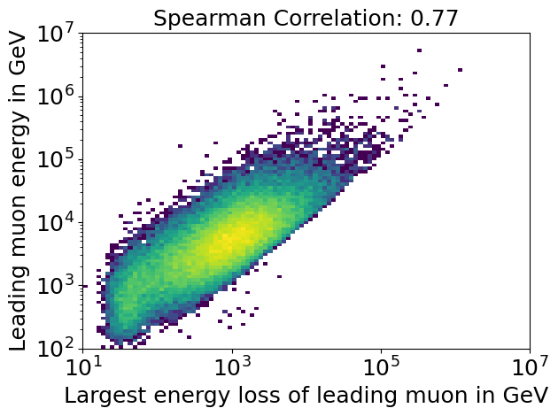
Stochasticity
Bundle energy cut
High stochasticity leads to high leadingness, but only for a small number of events
Leading muon energy smears out at large bundle energies
Largest energy loss of the leading muon correlates with the leading muon energy

Slide 32
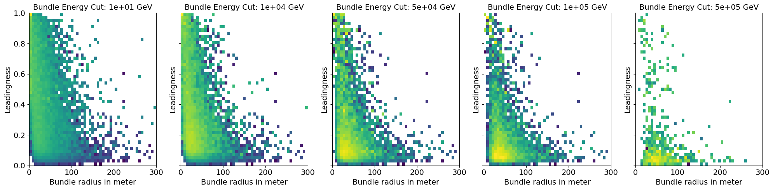
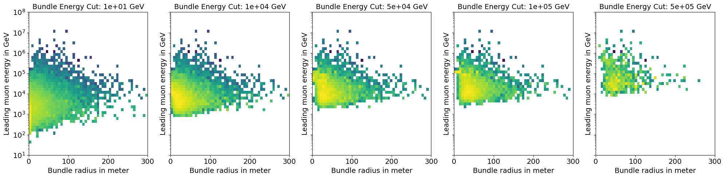
Bundle radius
Bundle energy cut
Large bundle radius leads to low leadingness

Slide 33
Data/MC

Slide 34
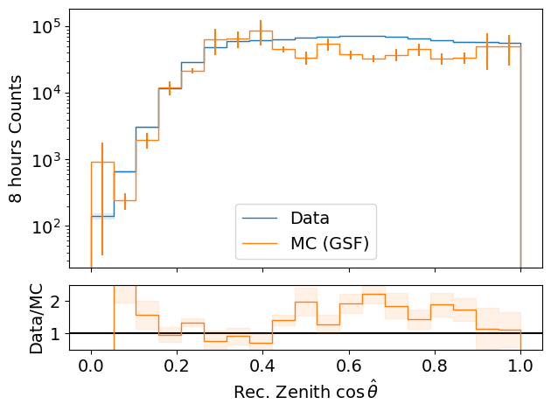
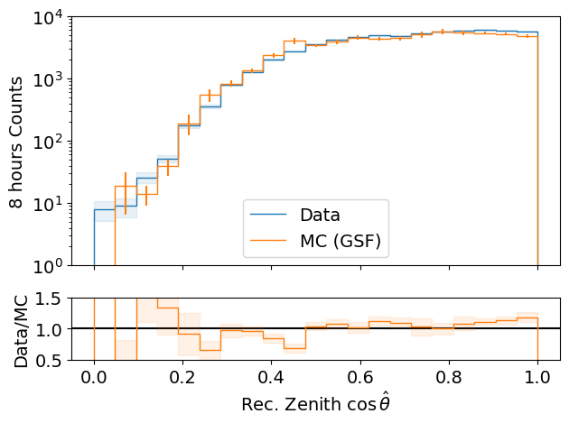
Data-MC: cos(zenith)
processed 8h of experimental data (June 4th, 2020)
L2 MuonFilter
Bundle energy > 100 TeV
L2 MuonFilter
Deviations at low cos(zenith), but very small statistics
More data at cos(zenith) > 0.5
Less data at cos(zenith) ~ 0.3

Slide 35
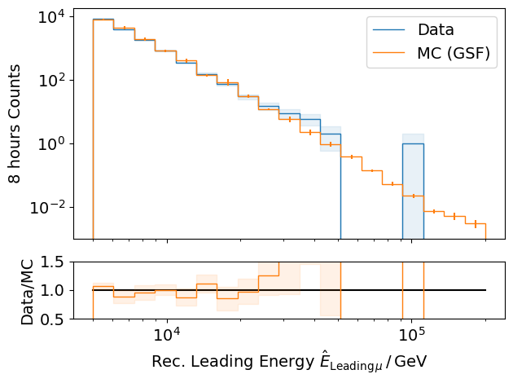
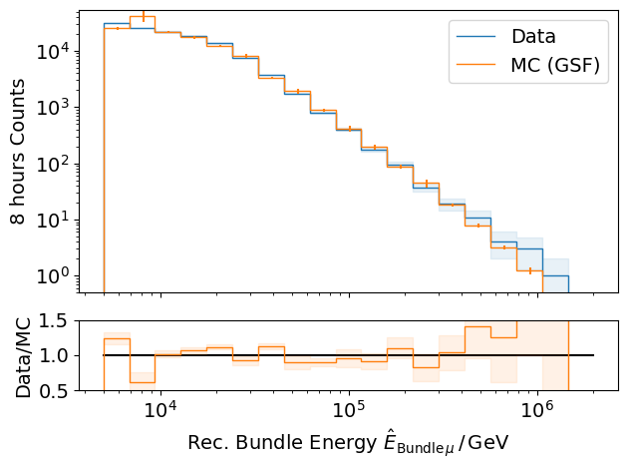
Data-MC: energy spectrum
processed 8h of experimental data (June 4th, 2020)
L2 MuonFilter
L2 MuonFilter
Bundle energy: good agreement with GSF up to 300 TeV
But insufficient statistics

Slide 36
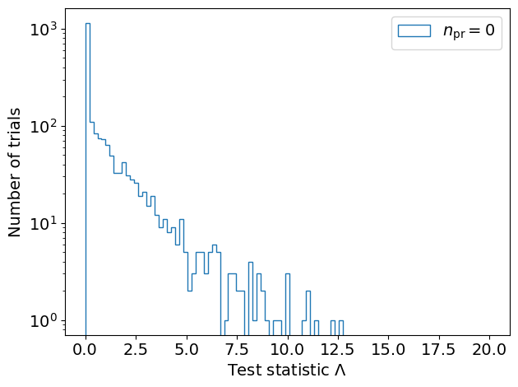
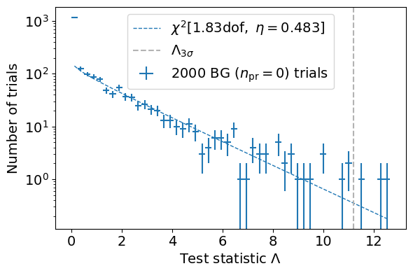
Test background statistics
Cuts:
L2 MuonFilter
Bundle energy > 100 TeV
Background statistic is 𝛘² – distributed
Assume Wilks’ theorem for test statistics

Slide 37
Conclusion and outlook
Next goal
Measure normalization of the atmospheric prompt muon flux
Steps for normalization
Verify CORSIKA extended history simulations
Tag prompt muons (see talk by Ludwig Neste)
Comparisons to MCEq (see talk by Ludwig Neste)
Set up preliminary analysis chain
Reconstruct muon energy and direction
Data/MC comparisons
Include systematics
Run full statistics simulation
✓
✓
✓
✓
★
★
Thank you for your attention ☺

Slide 38
Backup

Slide 39
Some definitions and wording…
Leading muon
The most energetic muon inside a bundle (no minimum fraction required)
Single muon
Except for stopping and very low energetic muons, there are never any single muons (almost every event is muon bundle)
Prompt muon
Muon parent is not pion or kaon
Suggestion:
To avoid confusion regarding different leading muon definitions we can introduce a “leadingness” (For example: Tomasz used a leadingness of 50%, …)
Most energetic muon inside
Muon parent:
pion or kaon
yes
no
conventional
prompt

Slide 40
Definition of the muon flux
$φ_{tot}=φ_{conventional}+φ_{prompt}$
$π, Κ$ ∝ E^{-3.7}
“not” $π, Κ \text{∝ }\text{E}\text{−}\text{2}\text{.7}$

Slide 41
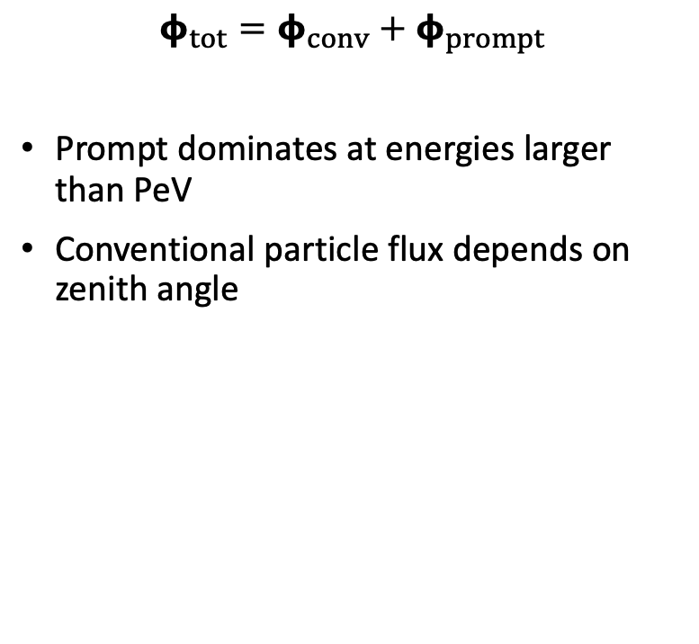
Muon flux
0°: perpendicular to Earth’s surface
$$φ_{tot}=φ_{conv}+φ_{prompt}$$
Prompt dominates at energies larger than PeV
Conventional particle flux depends on zenith angle
conventional
prompt
We can measure prompt muon energies from ~1 PeV to ~100 PeV

Slide 42

Muon production – different weightings
GST predicts most prompt
MCLabelsLeadingMuons_entry_energy

Slide 43


Solution to zenith problem?
No complete solution, but a step in the right direction

Slide 44

New CORSIKA extended history simulations
CORSIKA 77420
SIBYLL 2.3d
Icetray 1.5.1
5 components (p, He, N, Al, Fe)
Polyplopia: True
Trimshower: True
Ecuts1: 273 GeV (hadron min energy)
Ecuts2: 273 GeV (muon min energy)
Ecuts3: 10²⁰ GeV (electron min energy)
Ecuts4: 10²⁰ GeV (photon min energy)
4 datasets:
30010: 600 GeV – 1 PeV
30011: 1 PeV – 100 PeV
30012: 100 PeV – 1 EeV
30013: 1 EeV – 50 EeV
/data/sim/IceCube/2023/generated/CORSIKA_EHISTORY/
Please go ahead and test the datasets
Sufficient statistics above 1 PeV
Too few statistics at lower energies

Slide 45


Expected muons for 10 years: leading vs. bundle energy
Solid: conventional
Dashed: prompt
Different primary fluxes lead to different prompt fluxes
Bundle energy extends to higher energies

Slide 46

Simulated events
Passed muon filter

Slide 47


Which energies do we need to simulate?
L2 MuonFilter
Bundle energy > 100 TeV

Slide 48




Filters
Choose muon filter,
larger statistics at 10 TeV

Slide 49

Filters – passed events per leading energy

Slide 50













Data-MC: HitStatistics - SplitInIceDSTPulses
L2 MuonFilter
No further exclusions

Slide 51













Data-MC: HitStatistics - SplitInIceDSTPulses
L2 Muonfilter
Reconstructed bundle energy > 10 TeV
Good agreement for pulses

Slide 52
Evaluation of models used in pseudo analysis
Note: the DNN reconstruction models are still investigated! The models used here are in an early stage. So far, the two bachelor students have trained models with better performance.
Updates on the models and reconstructions are provided in the near future

Slide 53
Data-MC agreements
Two bachelor students worked on reconstructions using the dnn_reco framework (thesis available in english):
Leander Flottau
Benjamin Brandt
Reconstructions:
Leading energy
Leading fraction
Bundle energy
Multiplicity
Azimuth
Zenith
General:
Trained on uncleaned and 6µs cleaned muon pulses
Processed 8h of experimental data (June 4th, 2020)
Work in progress

Slide 54

Zenith reconstructions

Slide 55

Azimuth reconstructions

Slide 56

Angular resolution

Slide 57
Bundle radius - energy

Slide 58

Muon flux – bundle radius

Slide 59


Stochasticity
muon that loses much energy at the beginning
of the propagation
cumulated energy loss
continuous energy loss
track length
calculate the area between the “continuous muon energy loss” and the accumulated muon energy losses and normalize it
high stochasticity: area = 1
no stochasticity: area = 0

Slide 60
Bundle radius
calculate perpendicular distance between leading muon and closest point to detector center
reference point
calculate the distance between the leading muon and all the other muons at the reference point
analyze the distances weighted by their energy (100%, 99%, 95%,... energy containment)

Slide 61

The Muon Puzzle
”muon number”
2108.08341

Slide 62

Possible Solutions
Hans Dembinski

